Slide 1
Scott Cronin

Slide 2
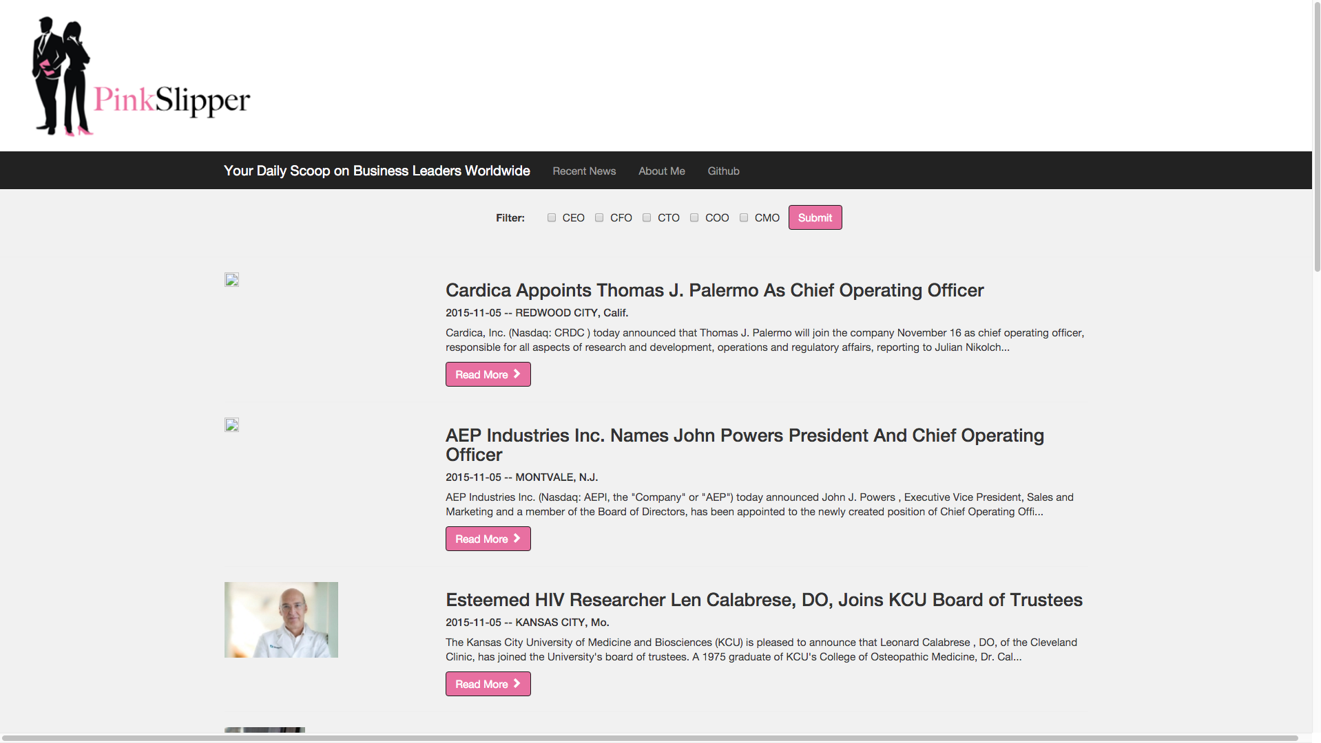

Slide 6
Collecting Data
10,000 articles scraped
Feature
Engineering
Cleaning
Notes:
To collect my data, I scraped 10,000 articles from PR Newswire, cleaned them up, and stored them in a MongoDB database. The features I tagged each word of a given headline with POS, location in the headline, all caps, all lowercase and a few others. Once the features were built, I needed to manually label a training set

Slide 7
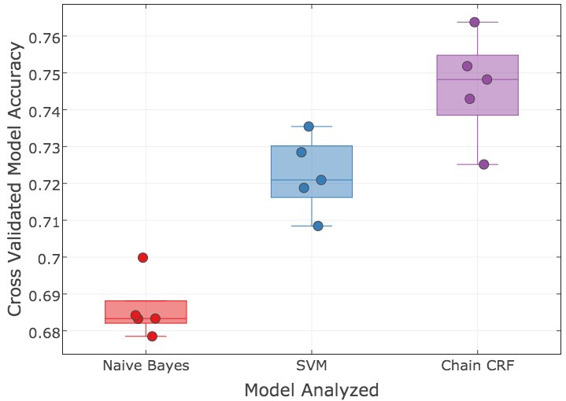
Model Development
5-Fold Cross-Validated modeling approach
Each point on graph is from a test fold
Chain CRF model was best
Notes:
To build my model, I used a cross validated approach on the 550 manually labelled headlines.

Slide 8
Model Development
5-Fold Cross-Validated modeling approach
Each point on graph is from a test fold
Chain CRF model was best
Word 1
Word 3
Word 2
Label 1
Label 2
Label 3
Notes:
To build my model, I used a cross validated approach on the 550 manually labelled headlines.

Slide 9
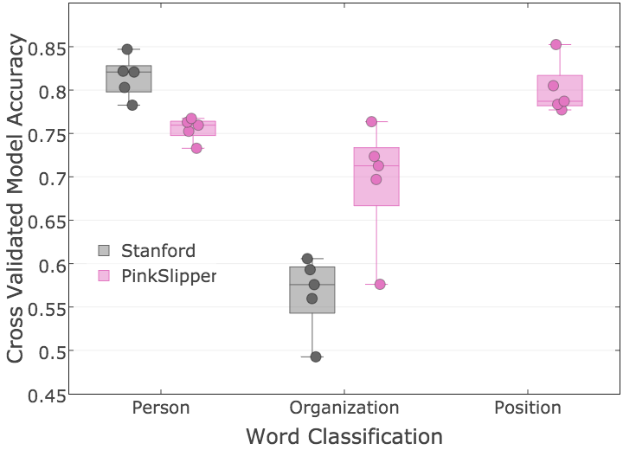
Stanford vs PinkSlipper Label Accuracy
Person:
Stanford better by 5%
Organization:
PinkSlipper better by 13%
Position:
PinkSlipper predicts 80%
Stanford does not predict
PinkSlipper Chain CRF works better for headlines

Slide 10
Model in Action
1. Fulcrum Equity Partners Promotes Philip Lewis to Principal
2. Stephen Bye named Chief Technology Officer for C Spire
3. Donald Steinberg Appointed as
Chairman and CEO of Converge Global Inc.
4. MasterCard Promotes Ed McLaughlin to CIO

Slide 11
Web App for Executive Recruiters

Slide 12


Slide 13
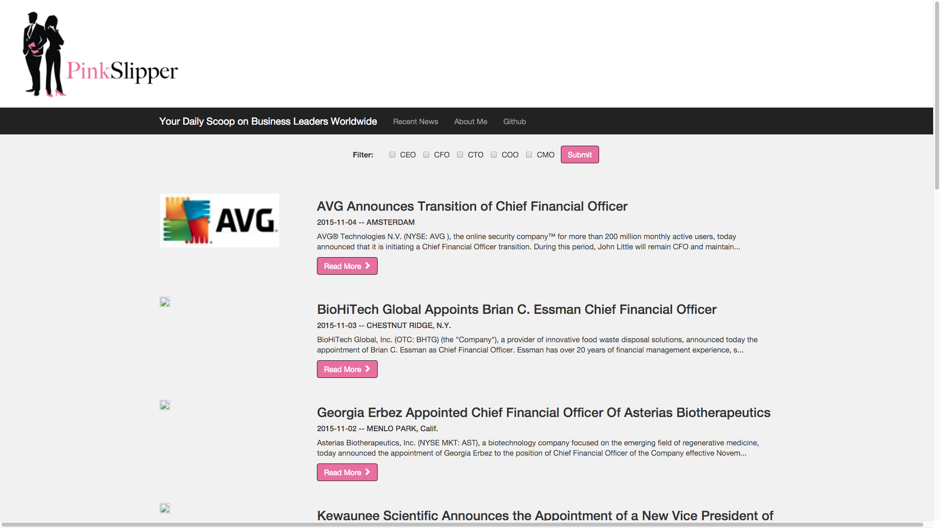

Slide 14
Scott Cronin

Slide 15
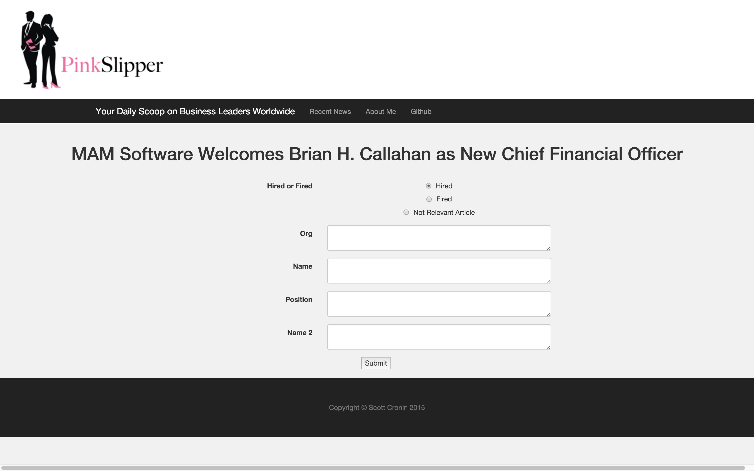
Label Training Data
Notes:
To label my data, I built a webapp which read in an article headline. I then copy pasted the person, organization, and position into this form, and stored the labels back in my database.

Slide 18
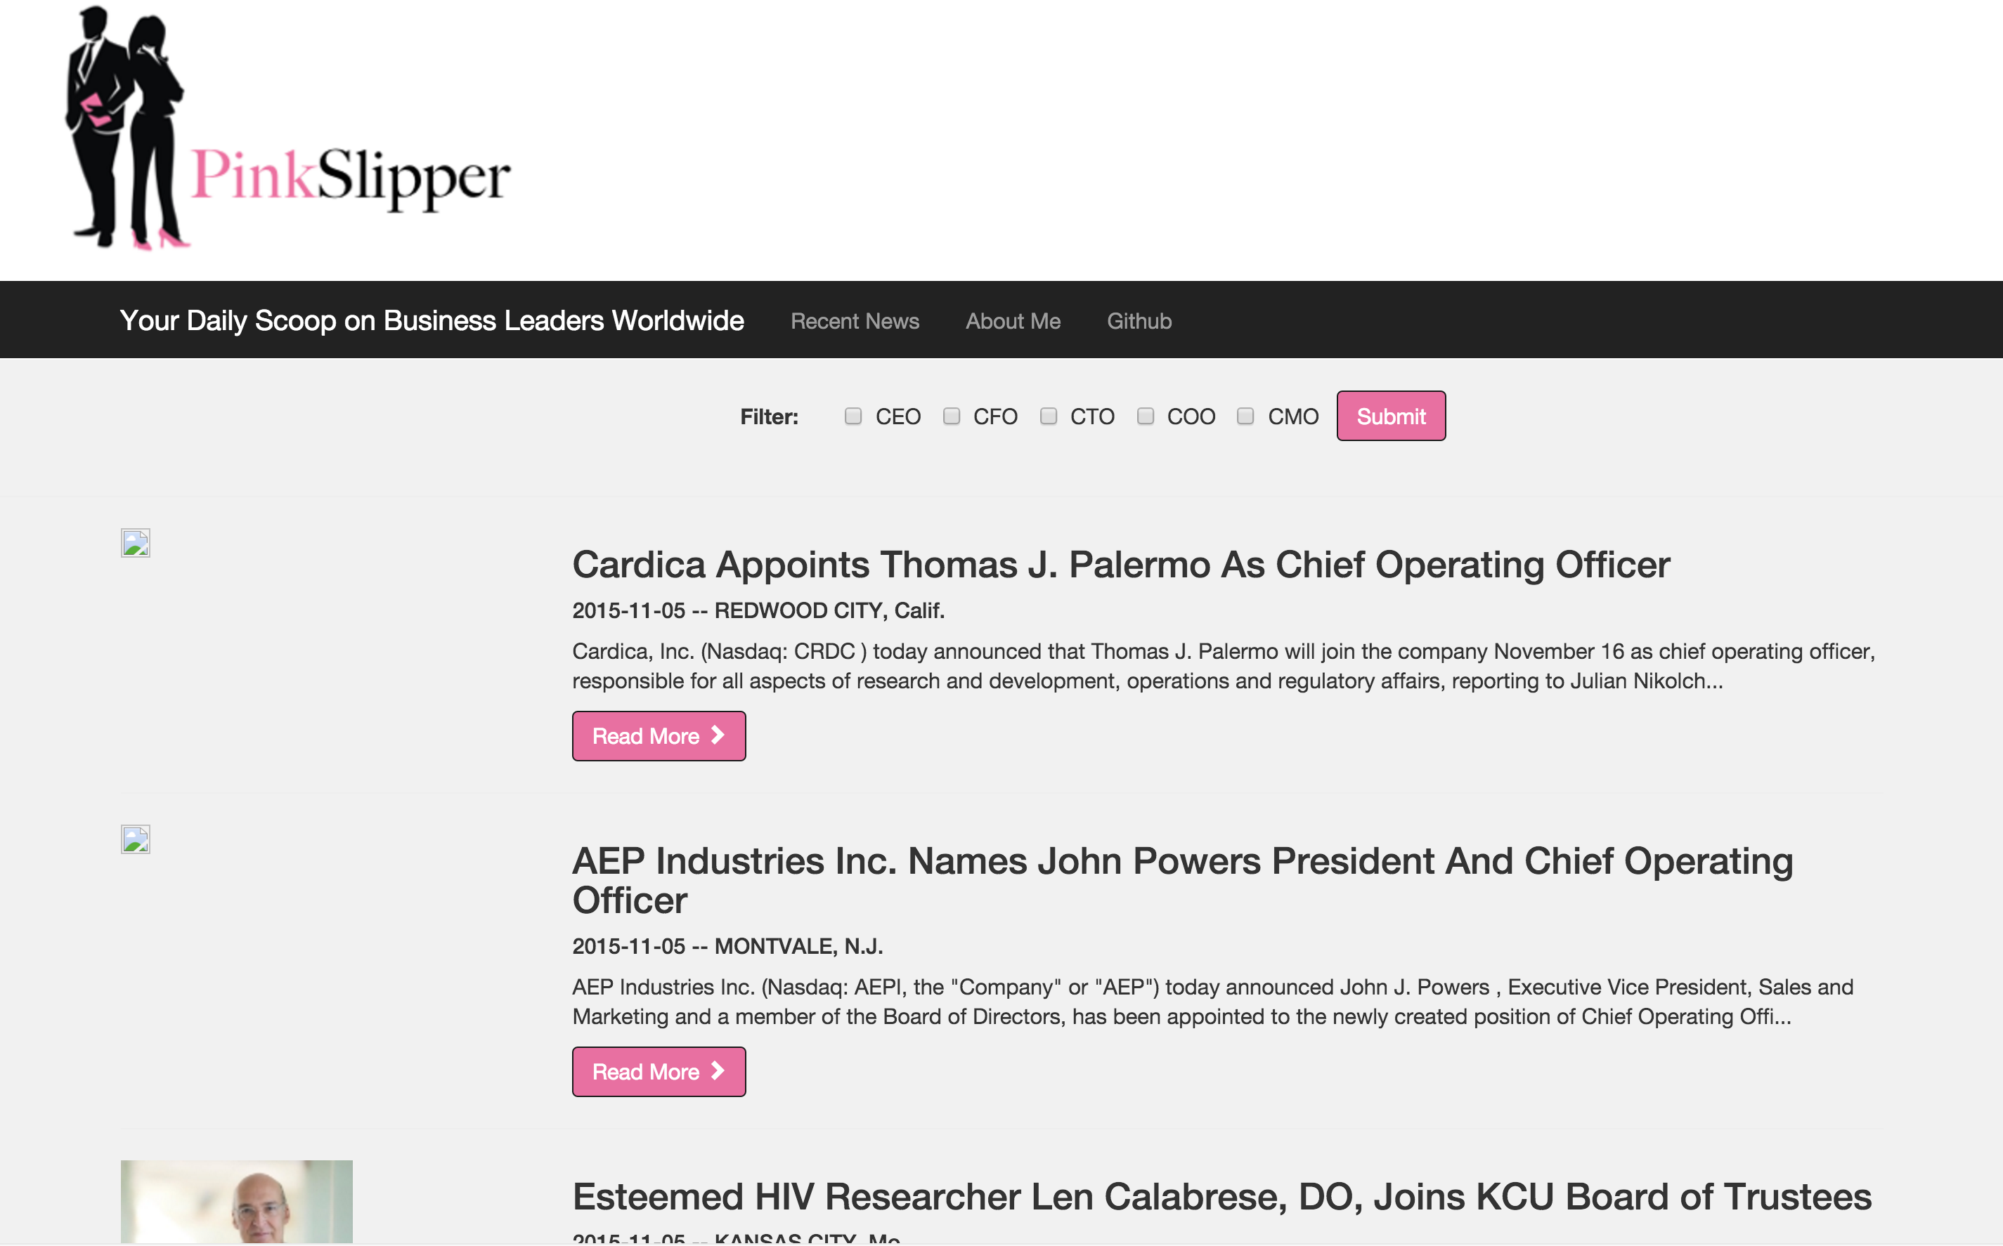
PinkSlipper
Notes:
PinkSlipper is a tool built for executive recruiters. It aggregates press releases relating to the hiring and firing of executives, and displays them in a simple and intuitive UI. Additionally, I trained a conditional random field model to analyze each word in a press release headline and label it as a person, organization, and position or other. I utilize these labels to filter the content on the site ensuring it is relevant for the executive recruiter.

Slide 19
PinkSlipper
Notes:
PinkSlipper is a tool built for executive recruiters. It aggregates press releases relating to the hiring and firing of executives, and displays them in a simple and intuitive UI. Additionally, I trained a conditional random field model to analyze each word in a press release headline and label it as a person, organization, and position or other. I utilize these labels to filter the content on the site ensuring it is relevant for the executive recruiter.

Slide 20
PinkSlipper
Notes:
PinkSlipper is a tool built for executive recruiters. It aggregates press releases relating to the hiring and firing of executives, and displays them in a simple and intuitive UI. Additionally, I trained a conditional random field model to analyze each word in a press release headline and label it as a person, organization, and position or other. I utilize these labels to filter the content on the site ensuring it is relevant for the executive recruiter.

Slide 21
PinkSlipper
Notes:
PinkSlipper is a tool built for executive recruiters. It aggregates press releases relating to the hiring and firing of executives, and displays them in a simple and intuitive UI. Additionally, I trained a conditional random field model to analyze each word in a press release headline and label it as a person, organization, and position or other. I utilize these labels to filter the content on the site ensuring it is relevant for the executive recruiter.

Slide 22
Pipeline
Collecting Data
Label Training Data
Building the model
Connecting pipeline
Front End Web App
Notes:
I built this app in 5 steps. First,

Slide 23

Purpose of Model
VASCO Appoints Scott Clements as Chief Strategy Officer

Slide 24
Purpose of Model
VASCO Appoints Scott Clements as Chief Strategy Officer

Slide 25
Purpose of Model
ORGANIZATION
PERSON
POSITION
VASCO Appoints Scott Clements as Chief Strategy Officer
OTHER
OTHER

Slide 26
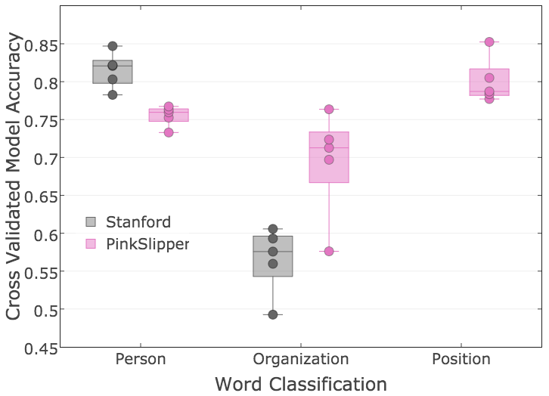
Stanford vs PinkSlipper Label Accuracy
Person:
Stanford better by 5%
Organization:
PinkSlipper better by 13%
Position:
PinkSlipper predicts 80%
Stanford does not predict
PinkSlipper Chain CRF works better for headlines

Slide 27
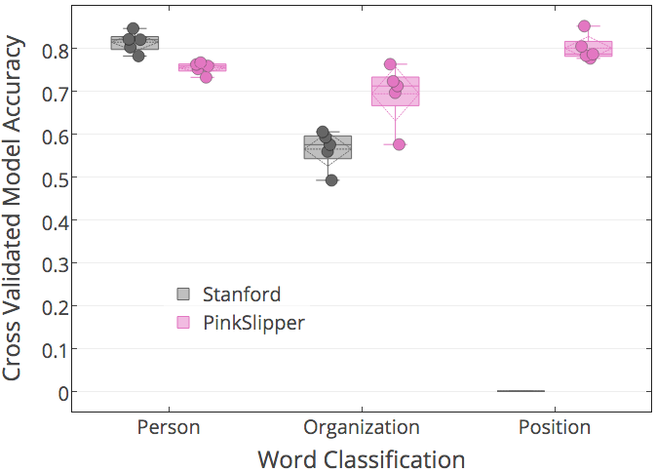
Stanford vs PinkSlipper Label Accuracy
Person:
Stanford better by 5%
Organization:
PinkSlipper better by 13%
Position:
PinkSlipper predicts 80%
Stanford not trained to predict
PinkSlipper Chain CRF works better for headlines

Slide 28
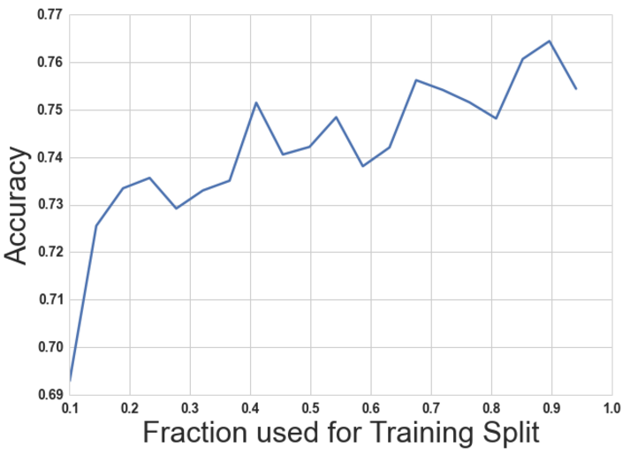
Accuracy vs Train Split Size
Training was done on 350 articles.
Increase training size from 30% to 70% (ie increasing from 100 articles to 250) improved model accuracy by 3%
Demonstrates some improvements in model, but there is limited return

Slide 29
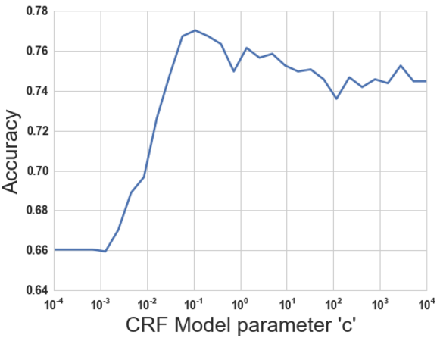
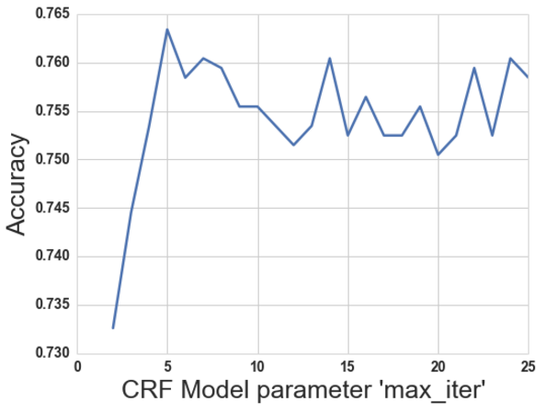
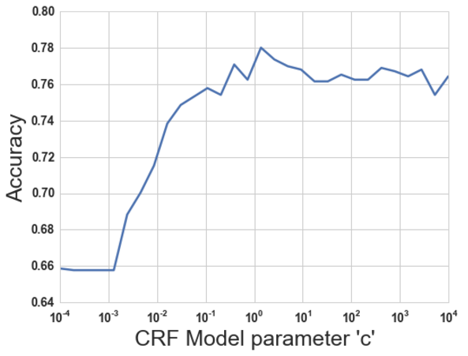
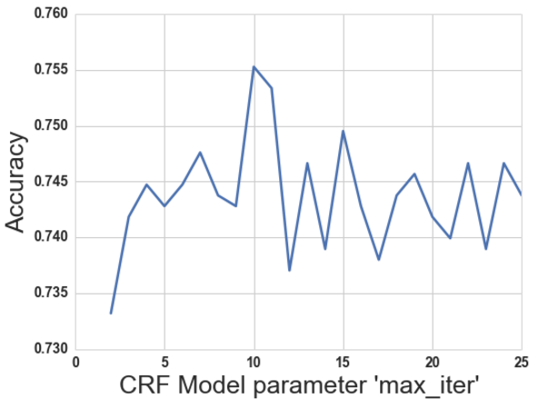
Model Tuning – Chain CRF
CRF Model parameter c = 0.5
CRF Model parameter max_iter = 11

Slide 30
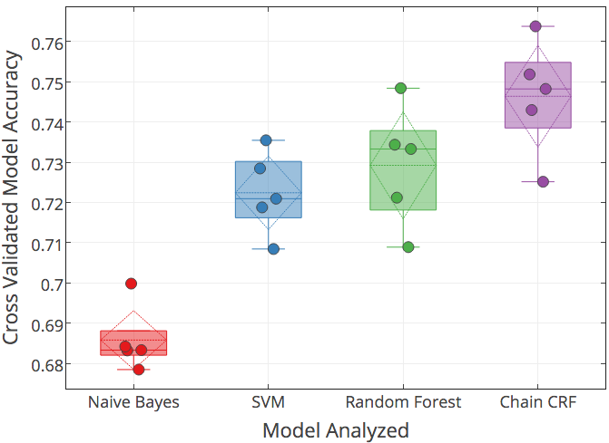
Model Development
Cross-Validated modeling approach using 550 labelled headlines
ChainCRF model was best

Slide 31
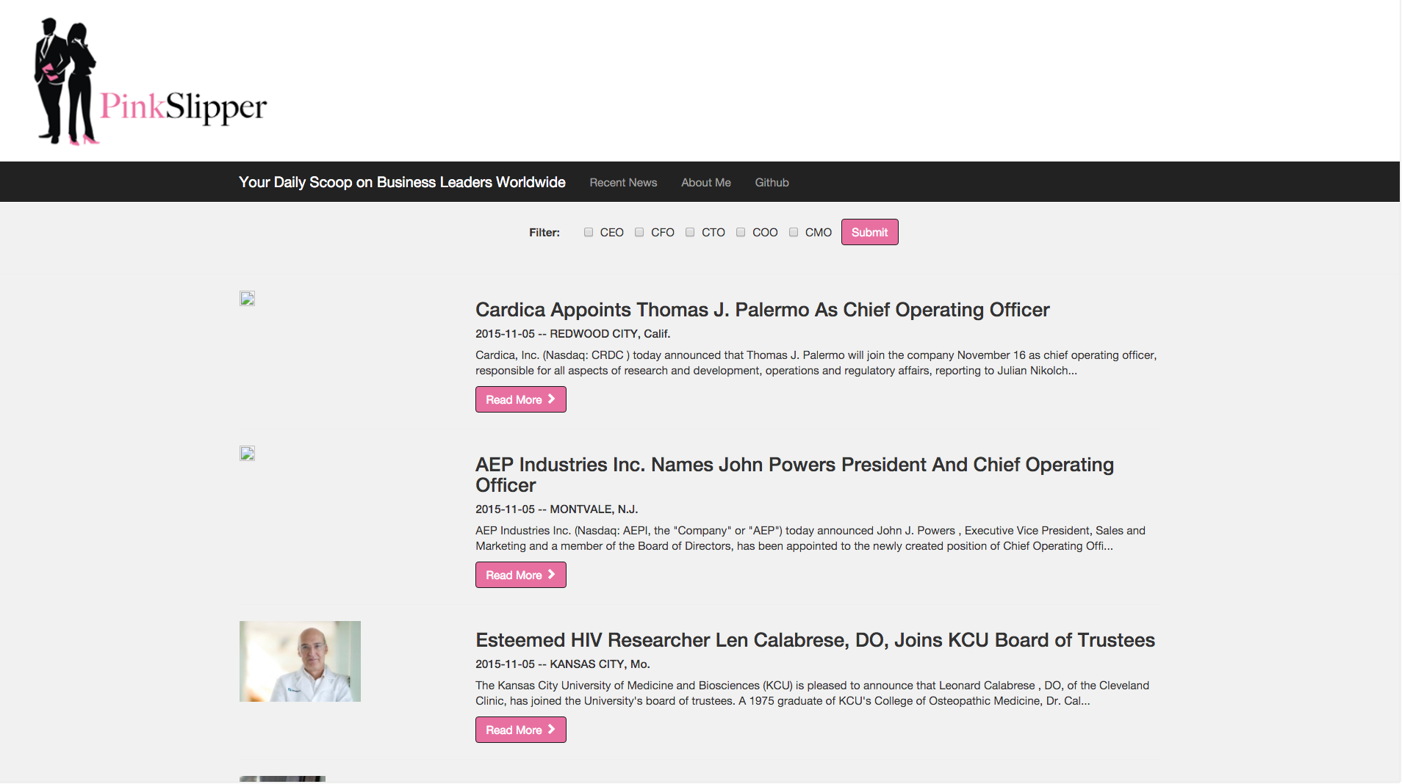
Demonstration

